Slide 1
Project documentation
Bike Sales Dataset
Hamza Lamrabet
Master Wirtschaftsinformatik
lamrabet@uni-hildesheim.de

Slide 2
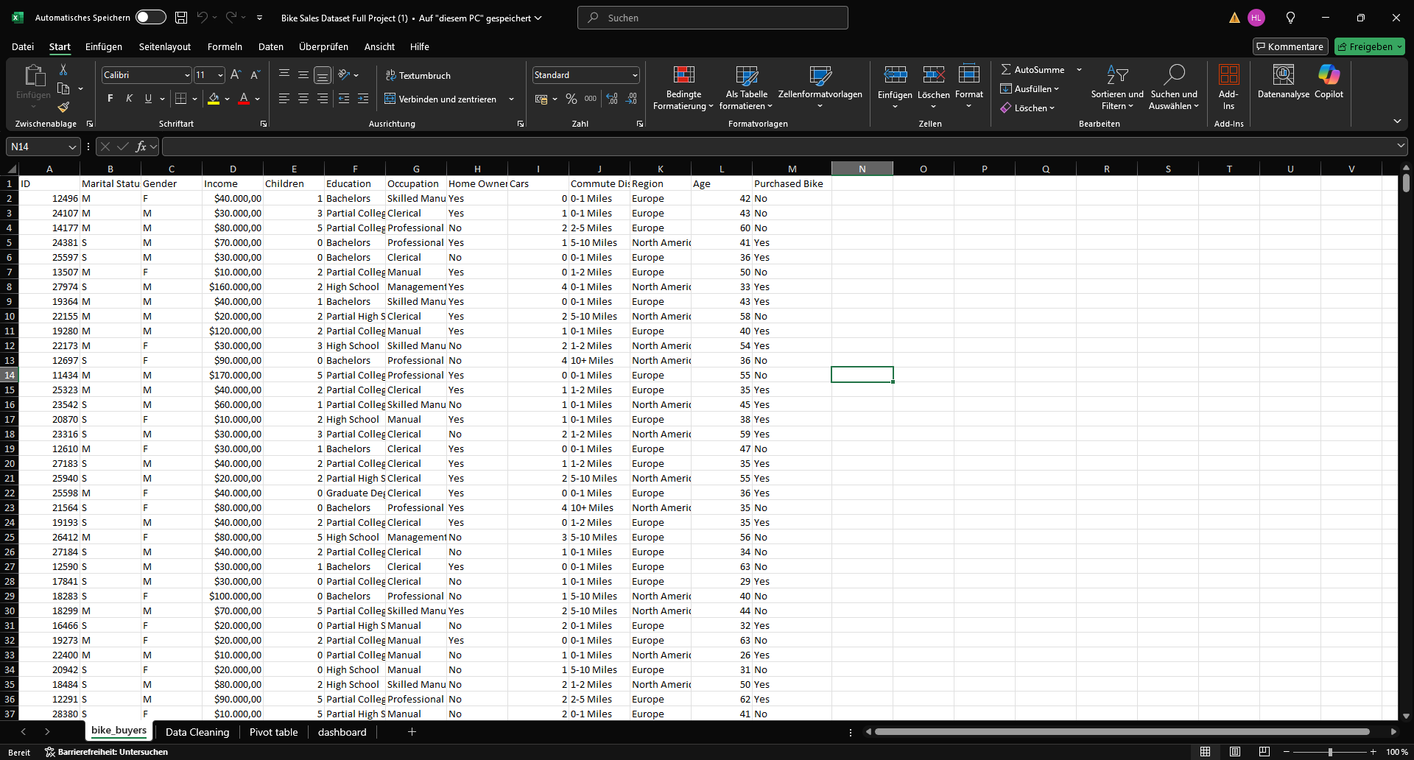
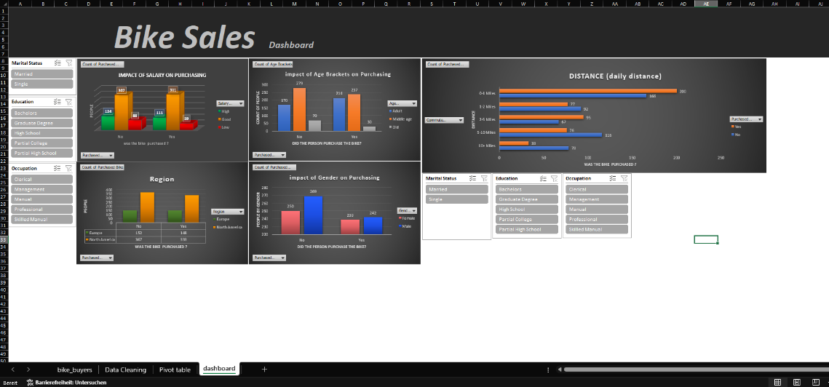
From Chaos to Clarity
Transforming raw data into valuable insights.
BEFORE
AFTER
Notes:
Hier kommen die Inhalte der Veranstaltung.

Slide 3

Agenda
Data Description
Data Cleaning and Preparation
Analysis and Visualizations
Findings and Insights
Notes:
Hier kommen die Inhalte der Veranstaltung.

Slide 4

Data Description
This dataset contains customer information, including demographic details (such as marital status, gender, income, education, occupation, children, and age), lifestyle factors (homeownership, number of cars, commute distance, region), and whether they purchased a bike.
The aim of this survey is to analyze bicycle preferences so that we can target the optimal customer segments to improve sales opportunities in the bicycle market.

Slide 5

Data Cleaning and Preparation
steps in the data cleaning and preparation phase, which are essential for making the dataset ready for analysis and visualization:
Remove Duplicates: Ensured each record is unique.
Find and Replace Values: Corrected inconsistencies in data (e.g. "Male" vs "male").
Categorize Data: Grouped values like income into categories (e.g. low, medium, high).
Other important cleaning tasks to focus on:
Handling Missing Data.
Converting Data Types.

Slide 6

Analysis and Visualizations
The process combines both analysis and visualization to not only explore the data but also present it in an engaging, interactive format.
Process :
Pivot Tables: help summarize and analyze the data effectively.
Charts: make trends and patterns easier to understand.
Dashboards: gather key insights in one interactive place.
Slicers: add interactivity, allowing easy filtering of data.

Slide 7

Findings and Insights
Income
People with higher incomes (over $80,000) and those with a good salary ($30,000 - $80,000) have more interest in purchasing a bike than people with a low income.
Commute Distance
People with a daily commute distance between one to five miles are more likely to purchase a bike, and those with a distance greater than five miles show even higher interest in bikes.
Region
In Europe and North America, around 49% of people from Europe and 47% from North America have purchased a bike, showing a similar interest across these regions.
Gender
There’s almost an equal interest in bike purchases between males (47%) and females (48%), with only a 1% difference.
Age
Adults between 25 and 39 years old, as well as people aged 40 to 60, show more interest in buying bikes compared to those over 61. Especially adults aged 40 to 60, with 55% of them already owning a bike.
These insights give you a clearer picture of the factors influencing bike purchases, which could be useful for targeting specific customer groups.

Slide 8
Attachment
Row Dataset

Slide 9
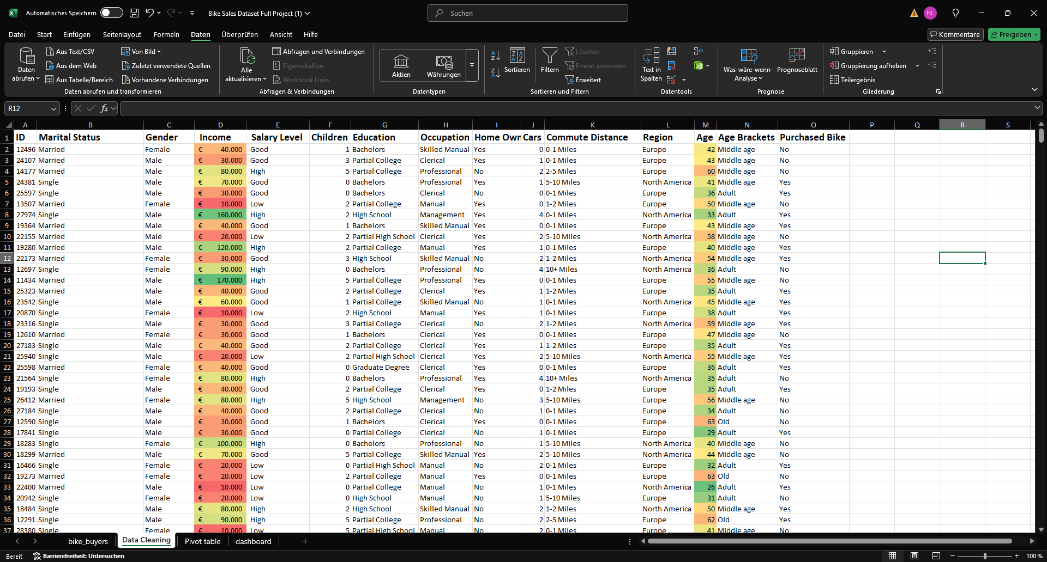
Attachment
Data Cleaning and Preparation

Slide 10
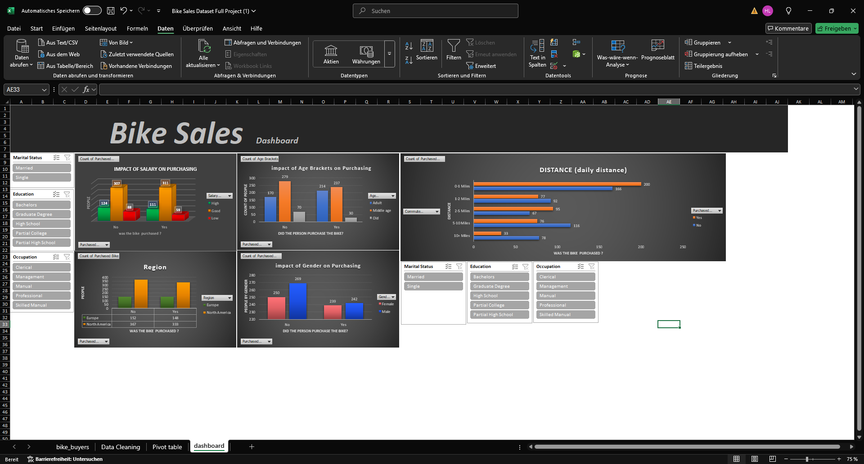
Attachment
Analysis and Visualizations

Slide 11
Thank you for your attention

